Slide 1
Diagrams that make sense – C4 Model
Francis Chung

Slide 2
Speaker Intro
Francis Chung
Staff Engineer at Shift
Co-Organiser of Alt.Net & DDD-AU Meetups
30+ years of experience in Banking, Finance, Fintech, Startups, EdTech, SAAS & AI
Insert footer source text here
01

Slide 3
Agenda
01 | Quick Intro to C4
02 | Closer Look
03 | Tooling for C4
04 | Live Mayhem | Demo(lition) time
05 | Q & A

Slide 4
Why do we even need C4?
“We already have well proven ways to draw diagrams”
“Even a 4 year old can understand my diagrams”
“C4 won’t be useful to me”
Insert footer source text here
01

Slide 5

Insert footer source text here
01

Slide 6
Let’s play a Game
Can some one tell me what the following diagrams are trying to describe?
Insert footer source text here
01

Slide 7
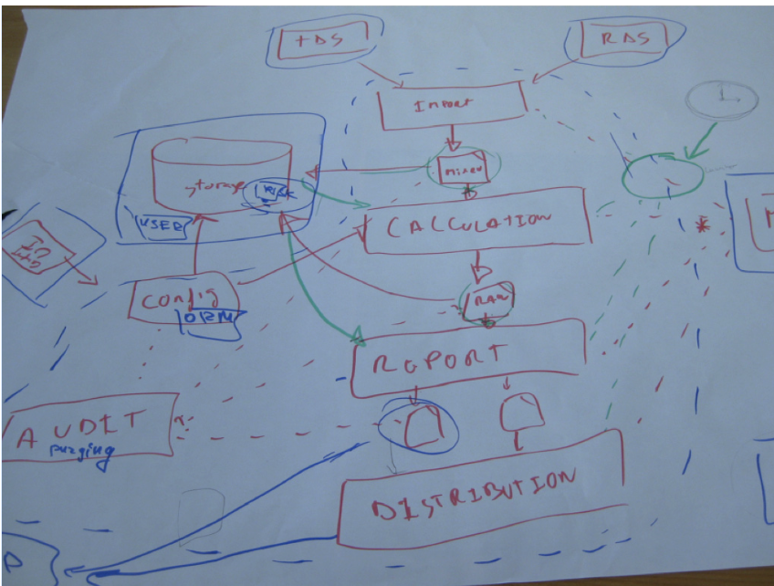
Insert footer source text here
01
Notes:
These are some examples for the C4 Book I’ll tell you about later.
Feel free to comment in the chat what’s wrong with this diagram
Did a 6 year old draw this?
What are the dotted lines?
Big ball of muddy mess
What do the coloured lines mean?
What are those unlabelled circles?
What are those unlabelled squares underneath report?
What is TDS? What is RDS? Hands up who’s guilty of drawing something like this? Don’t be shy now

Slide 8
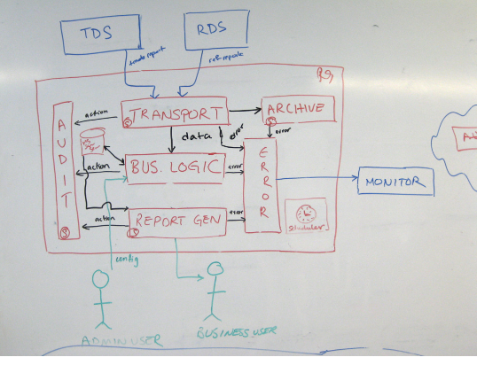
Notes:
This diagram is a bit better, but still have issues
What does action mean? What type of errors? Are they all the same error? Who ever has ever diagrammed an error component separately? Are they generating that many errors?
What does the red context border mean? What system does it represent? What Technology do you think they are using underneath?

Slide 9
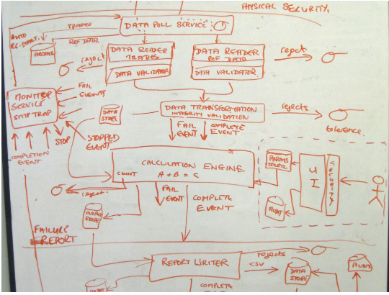
Insert footer source text here
01
Notes:
More complete diagram
Better labelling, but still incomplete
What are those circle with line symbols on top right?
There’s still no title?
What does “A + B = C” mean?

Slide 10
What’s wrong with the previous diagrams?
Insert footer source text here
01

Slide 11
What’s wrong with the previous diagrams?
No consistent methodology
1
Everyone seems to have their own standard of drawing diagrams
Insert footer source text here
01

Slide 12
What’s wrong with the previous diagrams?
No consistent methodology
A lot of context is missing
1
Everyone seems to have their own standard of drawing diagrams
2
Quite often, the author seems to assume the audience knows a lot of missing context that is not obvious
Insert footer source text here
01

Slide 13
What’s wrong with the previous diagrams?
No consistent methodology
A lot of context is missing
Intended audience could be bigger
1
Everyone seems to have their own standard of drawing diagrams
2
Quite often, the author seems to assume the audience knows a lot of missing context that is not obvious
3
Why should System Diagrams only be used by Developers?
Insert footer source text here
01
Notes:
So this is my top 3 reasons for what’s wrong with the previous diagrams
The last item will come as a bit of surprise, but traditionally System Diagrams was only used by Developers. Why should this be the case, especially in an era where there’s more collaboration between different teams (Product, Business etc) So is there a way to address the above issues?

Slide 14
Common Problems with System Diagrams
• Levels of abstraction are mixed.
• Notation (e.g. colour coding, shapes, etc) is not explained or is inconsistent.
• The purpose and meaning of elements is ambiguous.
• Relationships between elements are missing or ambiguous.
Insert footer source text here
01

Slide 15
Common Problems with System Diagrams
• Levels of abstraction are mixed.
• Notation (e.g. colour coding, shapes, etc) is not explained or is inconsistent.
• The purpose and meaning of elements is ambiguous.
• Relationships between elements are missing or ambiguous.
• Generic terms such as “business logic” are used.
• Technology choices (or options, if doing up front design) are omitted.
• Too much or too little detail.
• No context or a logical starting point.
Insert footer source text here
01

Slide 16
So what is C4?
Insert footer source text here
01

Slide 17
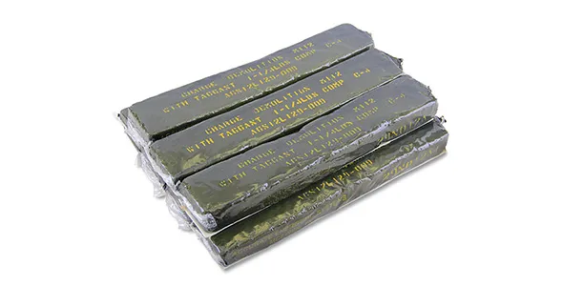
So what is C4?
Insert footer source text here
01
Notes:
Not this explosive guy … and No, I’m not moonlighting as a North Korean Arms Dealer ….

Slide 18

So what is C4 (really)?
Wikipedia : “The C4 model is a lean graphical notation technique for modelling the architecture of software systems.^{[1][2]} It is based on a structural decomposition of a system into containers and components”
My Take : “C4 model is an attempt to address deficiencies with traditional diagramming techniques by incorporating an ubiquitous vocabulary of well defined notation and components, to describe a system using multiple diagrams that represent different levels of abstractions and details”
Invented by Simon Brown, Author, Software Architect & Frequent Flyer from the UK
Insert footer source text here
01

Slide 19
What is C4 isn’t
It is not intended to replace your favourite beloved diagrams like
UML
Entity Relationship diagrams (ERD)
Sequence diagrams
Infrastructure diagrams
Deployment diagrams
Business Process Model Notation (BPMN)
etc etc
Insert footer source text here
01
Notes:
Who loves UML here? Hands up? No one? Why not? What’s wrong with you lot?

Slide 20
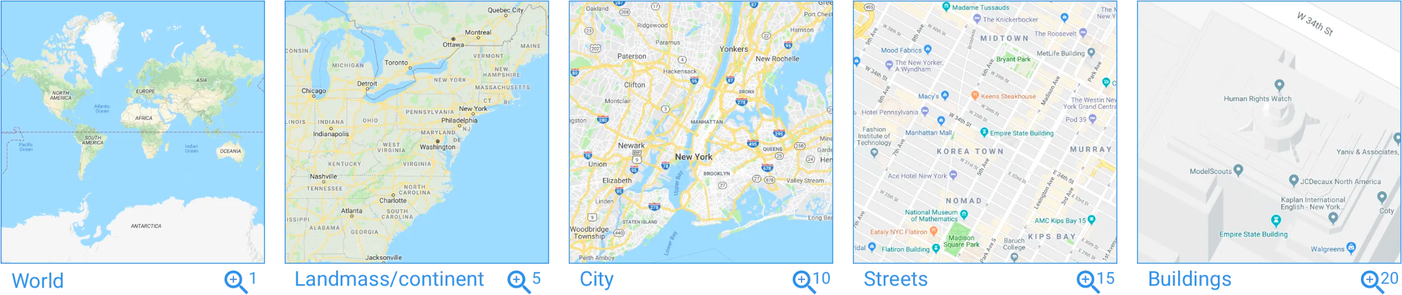
C4 in a nutshell (TLDR)
Think if Google Maps were a system diagram with different zoom levels
Insert footer source text here
01
Notes:
So this is another definition of C4 that might be the easiest to grasp, especially if you’re a visual learner.
<Slide>
Each “Map” shows different level of details and represent different level of abstraction(s)
…..
I noticed last night that the last map has zoomed into Korea Town.
I wasn;t in a late night Karaoke last weekend with Phil Nash, so don’t get any ideas

Slide 21
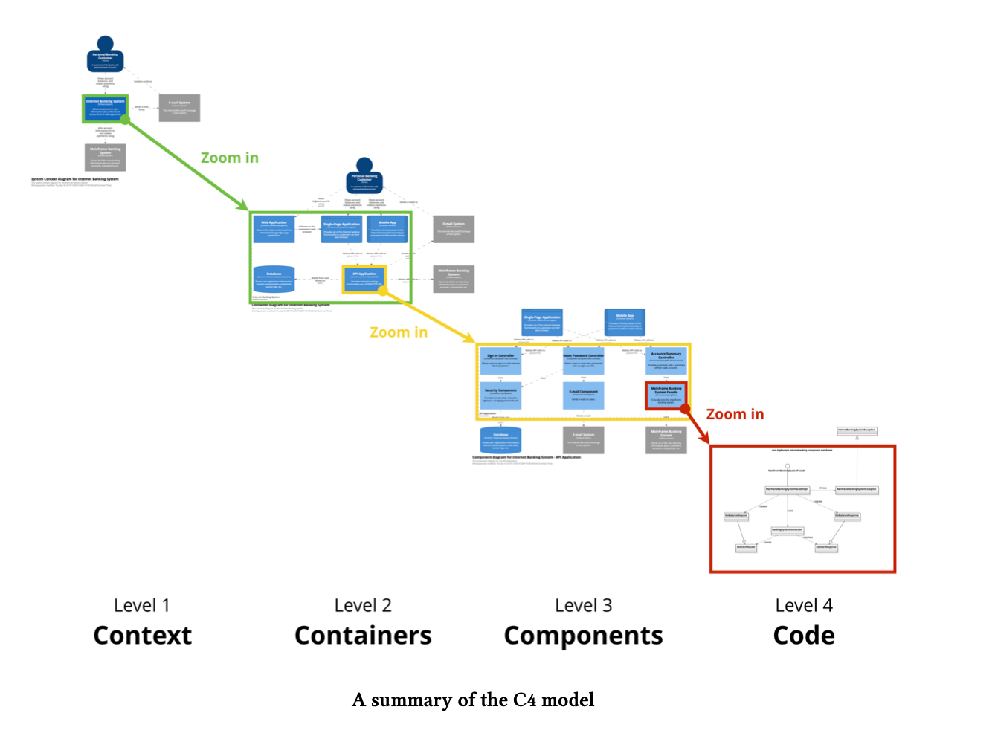
So what are the 4 Cs in C4?
Insert footer source text here
01
Notes:
SO I’m going to use the an internet banking system as an example.
It’s one I believe that most of the audience might be some what familiar with.
It’s also the same example Simon’s book uses (Plagarism alert!)
<Slide>
Don’t worry if you can’t see the details of these slides.
We’ll be taking a closer look shortly

Slide 22
But before we dive deeper into the Cs ….
Gotta know your ABCs and some vocabulary first !
Person
Software System
Container
Component
Insert footer source text here
01
Notes:
“... so you know what I’m talking about. Perhaps t
Person - Any User that is interacting with your System
Software System - Can either be your system or external system. External Systems are outside the scope of your own Systems. Systems that you have no responsibility or ownership of
Container - It is not a Docker Container. More on this later. A "container" is something like a web application, mobile app, desktop application, database, file system, etc. Essentially, a container is a separately deployable unit that executes code or stores data
Component - A functional unit within the Container, such as modules, set of classes or a set of interfaces. These can’t be deployed independently, unlike a container.

Slide 23
But before we dive deeper ….
Some Vocabulary first !
Person – Any user that is interacting with your System
Software System
Container
Component
Insert footer source text here
01
Notes:
“... so you know what I’m talking about. Perhaps t
Person - Any User that is interacting with your System
Software System - Can either be your system or external system. External Systems are outside the scope of your own Systems. Systems that you have no responsibility or ownership of
Container - It is not a Docker Container. More on this later. A "container" is something like a web application, mobile app, desktop application, database, file system, etc. Essentially, a container is a separately deployable unit that executes code or stores data
Component - A functional unit within the Container, such as modules, set of classes or a set of interfaces. These can’t be deployed independently, unlike a container.

Slide 24
But before we dive deeper ….
Some Vocabulary first !
Person – Any user that is interacting with your System
Software System – Can be your System or External Systems
Container
Component
Insert footer source text here
01
Notes:
“... so you know what I’m talking about. Perhaps t
Person - Any User that is interacting with your System
Software System - Can either be your system or external system. External Systems are outside the scope of your own Systems. Systems that you have no responsibility or ownership of
Container - It is not a Docker Container. More on this later. A "container" is something like a web application, mobile app, desktop application, database, file system, etc. Essentially, a container is a separately deployable unit that executes code or stores data
Component - A functional unit within the Container, such as modules, set of classes or a set of interfaces. These can’t be deployed independently, unlike a container.

Slide 25
But before we dive deeper ….
Some Vocabulary first !
Person – Any user that is interacting with your System
Software System – Can be your System or External Systems
Container – Deployable Unit that executes code or stores data (NOT DOCKER !)
Component
Insert footer source text here
01
Notes:
“... so you know what I’m talking about. Perhaps t
Person - Any User that is interacting with your System
Software System - Can either be your system or external system. External Systems are outside the scope of your own Systems. Systems that you have no responsibility or ownership of
Container - It is not a Docker Container. More on this later. A "container" is something like a web application, mobile app, desktop application, database, file system, etc. Essentially, a container is a separately deployable unit that executes code or stores data
Component - A functional unit within the Container, such as modules, set of classes or a set of interfaces. These can’t be deployed independently, unlike a container.

Slide 26
But before we dive deeper ….
Some Vocabulary first !
Person – Any user that is interacting with your System
Software System – Can be your System or External Systems
Container – Deployable Unit that executes code or stores data (NOT DOCKER !)
Component – Functional unit within a Container that can’t be deployed (e.g classes, modules)
Insert footer source text here
01
Notes:
“... so you know what I’m talking about. Perhaps t
Person - Any User that is interacting with your System
Software System - Can either be your system or external system. External Systems are outside the scope of your own Systems. Systems that you have no responsibility or ownership of
Container - It is not a Docker Container. More on this later. A "container" is something like a web application, mobile app, desktop application, database, file system, etc. Essentially, a container is a separately deployable unit that executes code or stores data
Component - A functional unit within the Container, such as modules, set of classes or a set of interfaces. These can’t be deployed independently, unlike a container.

Slide 27
… and some other key features
Name
Description – Because names aren’t enough
Arrows have descriptions too
A Title !
Insert footer source text here
01
Notes:
A lot of these features were missing in lots of places in the diagrams I’ve shown you before

Slide 28
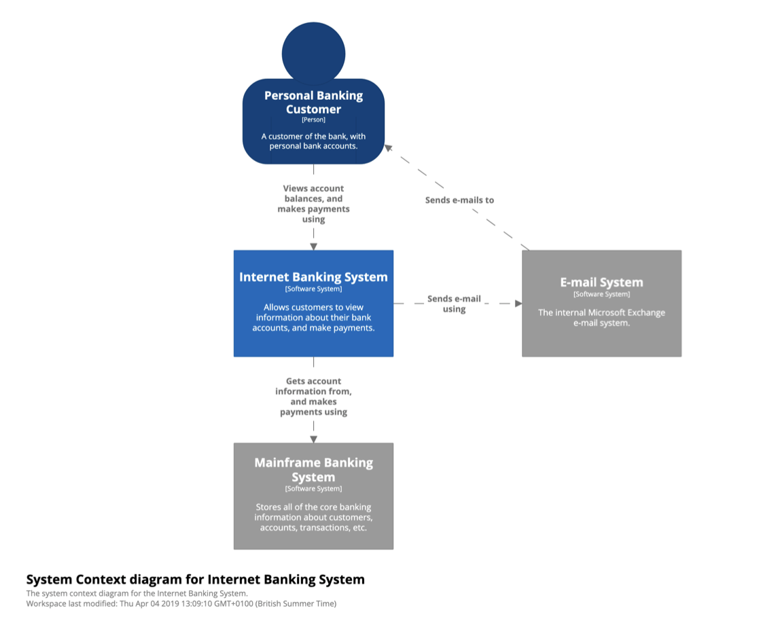
L1 - Context (or System Context)
Insert footer source text here
01
Notes:
Example from the book, imagine we’re the internet banking system team
The example here is to describe your system from a very zoomed out level if you like, and describing you system holistically.
The focus is on People and Software Systems that your system interacts with
The focus is NOT on technology, protocol and other low level tech details
Perfect place to show non technical people to open up discussions

Slide 29
L1 - Context (or System Context)
Key Points
The focus is on People and Software Systems that your system interacts with
The focus is NOT on technology, protocol and other low level tech details
Perfect place to show non technical people to open up discussions
Insert footer source text here
01
Notes:
Example from the book, imagine we’re the internet banking system team
The example here is to describe your system from a very zoomed out level if you like, and describing you system holistically.
The focus is on People and Software Systems that your system interacts with
The focus is NOT on technology, protocol and other low level tech details
Perfect place to show non technical people to open up discussions

Slide 30
L1 - What is the point of diagrams simple as L1?
Simplicity actually is the key feature here.
All context and scope of the system is explicit, so there are NO assumptions.
It shows what is being added (from a high-level) to an existing environment
It’s a high-level diagram that technical and non-technical people can use as a starting point for discussions.
It provides a starting point for identifying who you potentially need to go and talk to as far as understanding inter-system interfaces is concerned.
Insert footer source text here
01
Notes:
<Slide>
Is there any non technical people out there who didn’t understand this diagram?
That last 2 points is something I’ve come across a lot

Slide 31
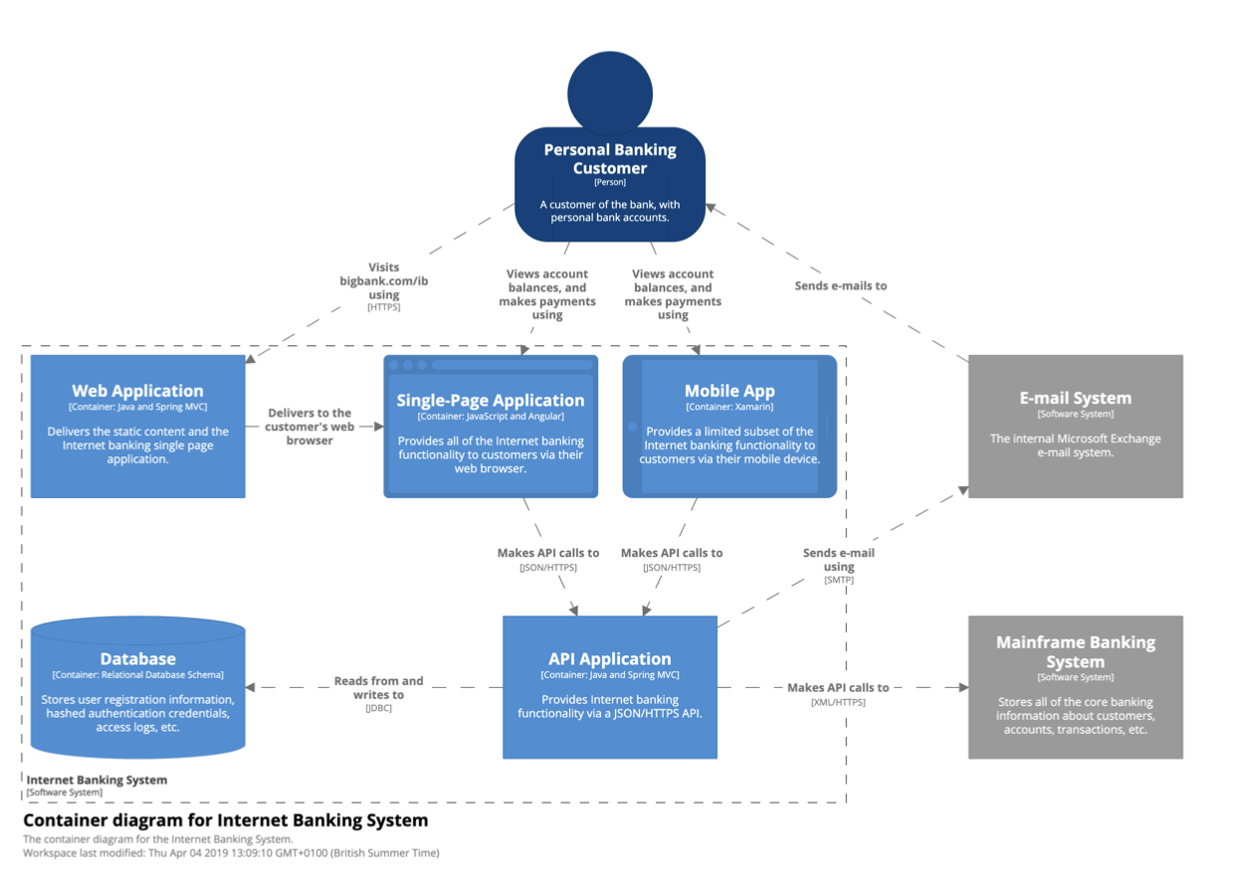
L2 - Container
Insert footer source text here
01
Notes:
A "container" is something like a web application, mobile app, desktop application, database, file system, etc. Essentially, a container is a separately deployable unit that executes code or stores data
Note Simon Brown claims he started using Container () before Docker was invented ().
Even though Container is now more associated with Docker, he refuses to budge.
I have to agree with him on this one.
(I have your back, Simon!)
Note the increase in detail here
For example the Person now has a lot more arrows describing the different interactions with different containers within the system

Slide 32
L2 - Container
It’s a high-level technology focussed diagram that is useful for technical people like Devs, Architects, Support etc
It shows the major technology choices, how they are used, and how containers communicate with each other.
Insert footer source text here
01
Notes:
As you drilldown, you’ll notice it starts to get a little bit more technology focused.
It may be of use to non IT/engineering people who knows a lot about technology (Basically your technical BAs/Producrt managers etc)
Note Simon Brown claims he started using Container () before Docker was invented ().
Even though Container is now more associated with Docker, he refuses to budge.
I have to agree with him on this one.
(I have your back, Simon!)
Note the increase in detail here
For example the Person now has a lot more arrows describing the different interactions with different containers within the system

Slide 33
L2 - Container
Insert footer source text here
01
Notes:
Now drilldown into the API Application
A "container" is something like a web application, mobile app, desktop application, database, file system, etc. Essentially, a container is a separately deployable unit that executes code or stores data
Note Simon Brown stared using Container () before Docker was invented ()
Note the increase in detail here
For example the Person now has a lot more arrows describing the different interactions with different containers within the system
Note Simon Brown claims he started using Container () before Docker was invented ().
Even though Container is now more associated with Docker, he refuses to budge.
I have to agree with him on this one.
(I have your back, Simon!)
Note the increase in detail here
For example the Person now has a lot more arrows describing the different interactions with different containers within the system

Slide 34
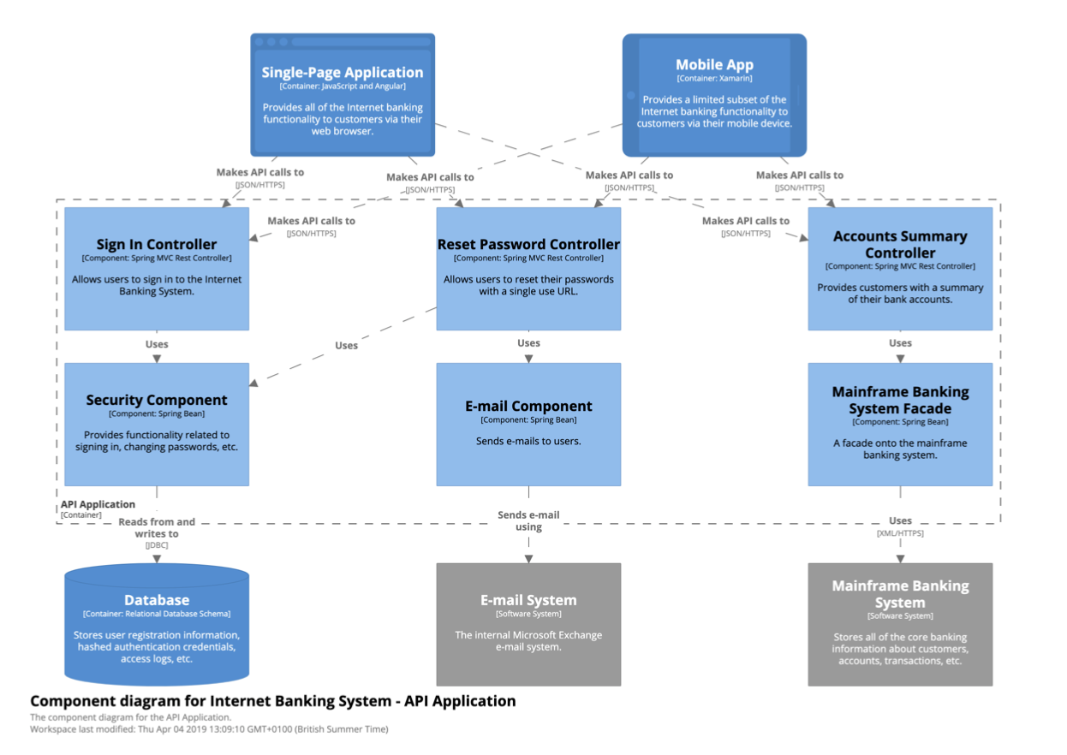
L3 - Component
Insert footer source text here
01
Notes:
Component definition -
A functional unit within the Container, such as modules, set of classes or a set of interfaces. These can’t be deployed independently, unlike a container.
This is what people usually draw when they’re asked to draw a System Diagram
Name: The name of the component.
Technology: The implementation technology for the component (e.g. Plain Old [Java|C#|Ruby|etc] Object, Enterprise JavaBean, Windows Communication Founda- tion service, etc).
Description:Ashortdescriptionofthecomponent,usuallyabriefsentencedescribing the component’s responsibilities.
Abstraction element representing the internals of the container of such modules or a set of interfaces that can be grouped as a functional unit. In Java or C# terms, they can be seen as a set of classes implemented for interfaces or packages. They differ from containers as these cannot be deployed independently.

Slide 35
L3 – Component Level (Key Points)
It shows the high-level decomposition of a container into components, each with distinct responsibilities.
It shows where there are relationships and dependencies between components.
It provides a high-level summary of the implementation details, including any frameworks or libraries being used.
Insert footer source text here
01
Notes:
L3 is where you’re decomposing some of your containers to the component level (major building blocks if you like of your application)
We’re seeing some of the interactions amd dependencies on it.
If there’s a good mapping between the component and code for example, then you have a really good starting point for newbies to understand the structure of your codebase

Slide 36
L3 – Component Level (Key Points)
It shows the high-level decomposition of a container into components, each with distinct responsibilities.
It shows where there are relationships and dependencies between components.
It provides a high-level summary of the implementation details, including any frameworks or libraries being used.
If the components shown on the diagram can be explicitly mapped to the code, you have a good way to really understand the structure of a codebase.
C4 diagrams are great for onboarding new technical staff, arguably L3 the most useful to some (and L2 to others)
Might not want to adopt as an optional level of detail for long-lived documentation -> Potentially high degree of effort involved in creating the diagrams and keeping them up to date
Insert footer source text here
01
Notes:
L3 is where you’re decomposing some of your containers to the component level (major building blocks if you like of your application)
We’re seeing some of the interactions amd dependencies on it.
If there’s a good mapping between the component and code for example, then you have a really good starting point for newbies to understand the structure of your codebase

Slide 37
L3 - Component
Insert footer source text here
01
Notes:
Drilling into the Mainframe banking System Facade Component definition -
A functional unit within the Container, such as modules, set of classes or a set of interfaces. These can’t be deployed independently, unlike a container.
This is what people usually draw when they’re asked to draw a System Diagram
Name: The name of the component.
Technology: The implementation technology for the component (e.g. Plain Old [Java|C#|Ruby|etc] Object, Enterprise JavaBean, Windows Communication Founda- tion service, etc).
Description:Ashortdescriptionofthecomponent,usuallyabriefsentencedescribing the component’s responsibilities.
Abstraction element representing the internals of the container of such modules or a set of interfaces that can be grouped as a functional unit. In Java or C# terms, they can be seen as a set of classes implemented for interfaces or packages. They differ from containers as these cannot be deployed independently.

Slide 38
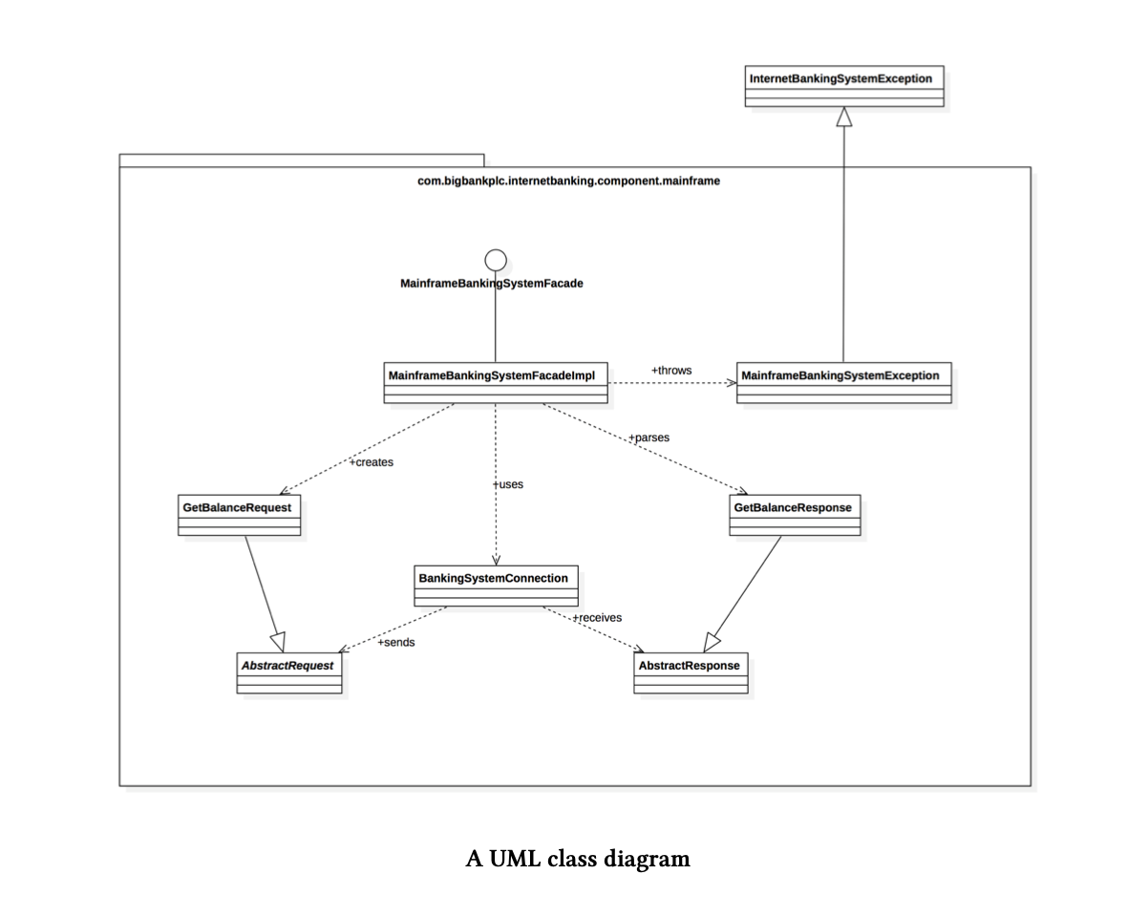
L4 - Code
Insert footer source text here
01
Notes:
So earlier, I may have taken the piss out of UML, and that should have been a hint of things to come as …..
For L4, Simon actually didn’t invent anything for L4, the code level.
He recommends using traditional methods as such as UML or Class Diagrams.
Also he recommends using a tool rather than hand generating it :)
Is it just me or are you feeling a little bit ripped off here, bit of bait and switch going on.
Perhaps I should start a lobby saying this should be called C3+1 or C3 + U or C3 + UML
(Maybe I dont have your back on this part, Simon!)

Slide 39
L4 – Code (Keypoints)
Map the high-level, coarse-grained components into real-world code elements.
It helps to bridge the software architecture and the code, which are very different.
Please use a tool to generate this
Can get very messy very quickly, so limit your scope when generating
Insert footer source text here
01
Notes:
So I just mentioned tools, which leads us to the next section ….

Slide 40
L4 – Code (Keypoints)
Map the high-level, coarse-grained components into real-world code elements.
It helps to bridge the software architecture and the code, which are very different.
Please use a tool to generate this
Can get very messy very quickly, so limit your scope when generating
Insert footer source text here
01
Notes:
So I just mentioned tools, which leads us to the next section ….

Slide 41
Misc Diagrams
(Not covered in this talk)
System Landscape Diagram – Think of a System Context diagram but expanded to included other systems. (System Context was focused on 1)
Dynamic Diagram – A version of a UML Sequence Diagram
Deployment Diagram – A version of UML Deployment Diagram
Insert footer source text here
01
Notes:
So I just mentioned tools, which leads us to the next section ….

Slide 42
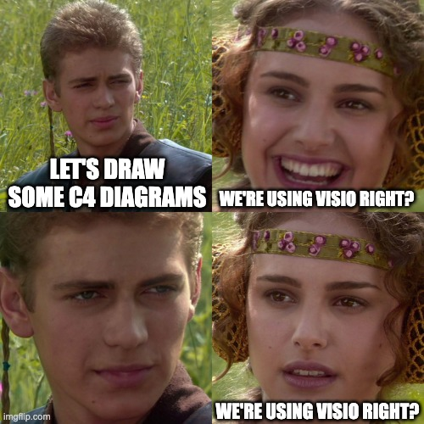
Tooling
Insert footer source text here
01
Notes:
“For the love of god ….. please don’t use Visio to draw C4 diagrams”

Slide 43
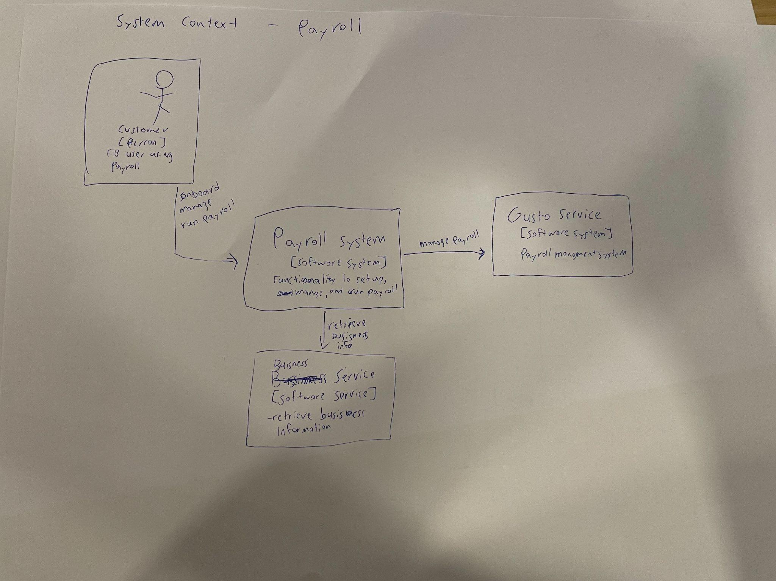
Notes:
This is why you don’t want to hand draw C4 Diagrams. But I do encourage people to try it as a learning experience

Slide 44
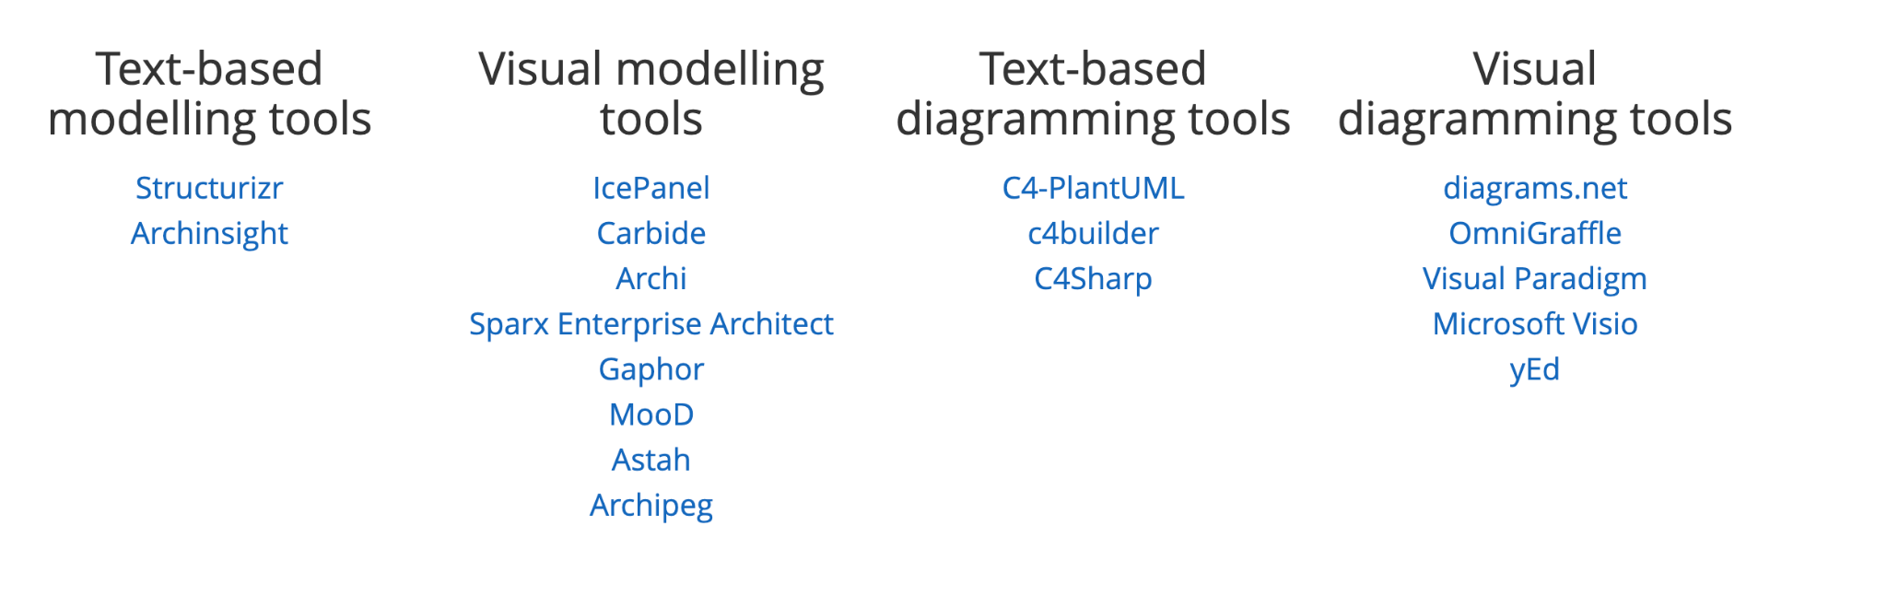
List of Tools
Insert footer source text here
01
Notes:
SO I’m going to use the an internet banking system as an example.
It’s one I believe that most of the audience might be some what familiar with.
It’s also the same example Simon’s book uses (Plagarism alert!)
<Slide>
Don’t worry if you can’t see the details of these slides.
We’ll be taking a closer look shortly

Slide 45
List of Tools (Evaulated)
Visio (Unfriend me now)
Diagrams.net (Formerly Draw.io)
PlantUML
Structurizr
Insert footer source text here
01
Notes:
PlantUML and Structurizr - Semantic

Slide 46
List of Tools (Evaulated)
Visio (Unfriend me now)
Diagrams.net (Formerly Draw.io)
PlantUML
Structurizr <--- My Recommendation
Insert footer source text here
01

Slide 47
Why Structurizr?
Free and Open Sourced
Built by the author of C4 – Simon Brown
Modelling Diagram as Code
1
It’s the only tool that is built from the ground up with C4 in mind
2
Easier to maintain and track if your model changes in the future
3
We all love free right?
Insert footer source text here
01
Notes:
Really no tool out there treats C4 model as a first class citizen. And it’s still free. Some additional features that’s been added since I last evaluated that wont be covered here
Ability to reverse engineer Java Code
Using it to publish ADRs

Slide 48
Resources | References
C4
C4 Website
https://c4model.com/
Leanpub
The C4 model for visualising software architecture
https://leanpub.com/visualising-software-architecture
Structurizr
https://github.com/structurizr
https://structurizr.com/
Cheat Sheet
https://static.codingthearchitecture.com/c4.pdf
https://c4model.com/
https://leanpub.com/visualising-software-architecture
https://medium.com/google-design/google-maps-cb0326d165f5
Insert footer source text here
01

Slide 49
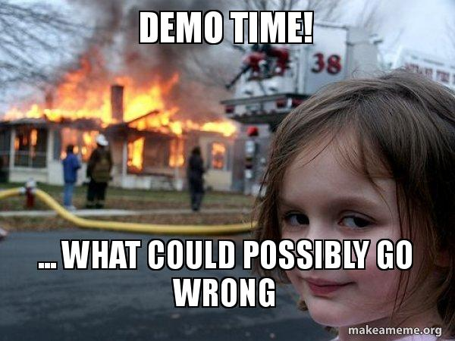
Insert footer source text here
01
Notes:
docker run -it --rm -p 8080:8080 -v /Users/francis.chung/Documents/personal/structurizr/examples/dsl/financial-risk-system/:/usr/local/structurizr structurizr/lite

Slide 50

Insert footer source text here
01

